Slide 1
Flutter
High-Fi Prototype
github link
Chloe B., Cynthia L., Amy X., Jenny Z.

Slide 2
declutter meaningfully
People often find themselves keeping a lot of clutter. Many of these objects stay because they hold sentimental value, but not necessarily functional use.
Flutter adds emotional security to the decluttering process, allowing people to find others who will value or add meaning to the object.
overview
HE feedback
design changes
implementation
status + plan
objective
tasks
value proposition
problem
solution

Slide 3
declutter meaningfully
People often find themselves keeping a lot of clutter. Many of these objects stay because they hold sentimental value, but not necessarily functional use.
Flutter adds emotional security to the decluttering process, allowing people to find others who will value or add meaning to the object.
overview
HE feedback
design changes
implementation
status + plan
objective
tasks
value proposition
problem
solution

Slide 4
declutter meaningfully
People often find themselves keeping a lot of clutter. Many of these objects stay because they hold sentimental value, but not necessarily functional use.
Flutter adds emotional security to the decluttering process, allowing people to find others who will value or add meaning to the object.
overview
HE feedback
design changes
implementation
status + plan
objective
tasks
value proposition
problem
solution

Slide 5
declutter meaningfully
People often find themselves keeping a lot of clutter. Many of these objects stay because they hold sentimental value, but not necessarily functional use.
Flutter adds emotional security to the decluttering process, allowing people to find others who will value or add meaning to the object.
overview
HE feedback
design changes
implementation
status + plan
objective
tasks
value proposition
problem
solution

Slide 6
find an object
give an object
connect and create new experiences
create groups to give and receive objects in
share new experiences with received object
overview
HE feedback
design changes
implementation
status + plan
objective
tasks
simple
medium
complex

Slide 7
find an object
give an object
connect and create new experiences
create groups to give and receive objects in
share new experiences with received object
overview
HE feedback
design changes
implementation
status + plan
objective
tasks
simple
medium
complex

Slide 8
find an object
give an object
connect and create new experiences
create groups to give and receive objects in
share new experiences with received object
overview
HE feedback
design changes
implementation
status + plan
objective
tasks
simple
medium
complex

Slide 9
find an object
give an object
connect and create new experiences
create groups to give and receive objects in
share new experiences with received object
overview
HE feedback
design changes
implementation
status + plan
objective
tasks
simple
medium
complex

Slide 10
overview
HE feedback
design changes
implementation
status + plan
stories, fundamentally
what happened to valuing and finding meaning in the object?
exchanging object
the process for exchanging objects is confusing
users might want to undo “mark object as given”
tagging and searching
hashtags next to usernames and groups are confusing
users might want to search by object description instead of giver
editing objects (and later, stories)
users are unable to edit objects

Slide 11
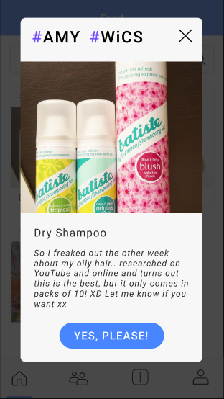
overview
HE feedback
design changes
implementation
status + plan
stories
how to exchange
search
edit
stories, fundamentally
what happened to valuing and finding meaning in the object?

Slide 12
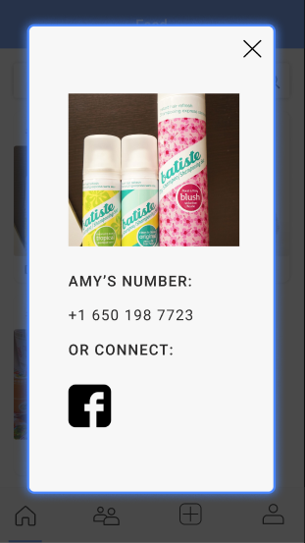
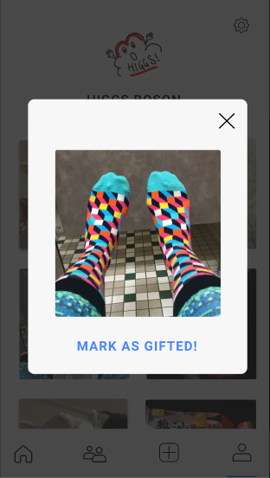
overview
HE feedback
design changes
implementation
status + plan
stories
how to exchange
search
edit
how to exchange?
the process for exchanging objects is confusing

Slide 13
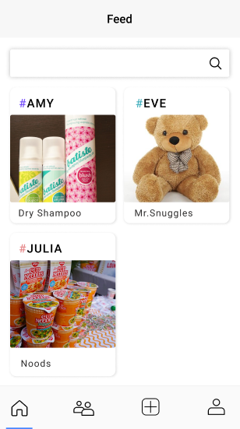
overview
HE feedback
design changes
implementation
status + plan
stories
how to exchange
search
edit
tagging and searching
hashtags next to usernames and groups are confusing
users might want to search by object description instead of giver

Slide 14
overview
HE feedback
design changes
implementation
status + plan
stories
how to exchange
search
edit
editing objects
users are unable to edit objects

Slide 15
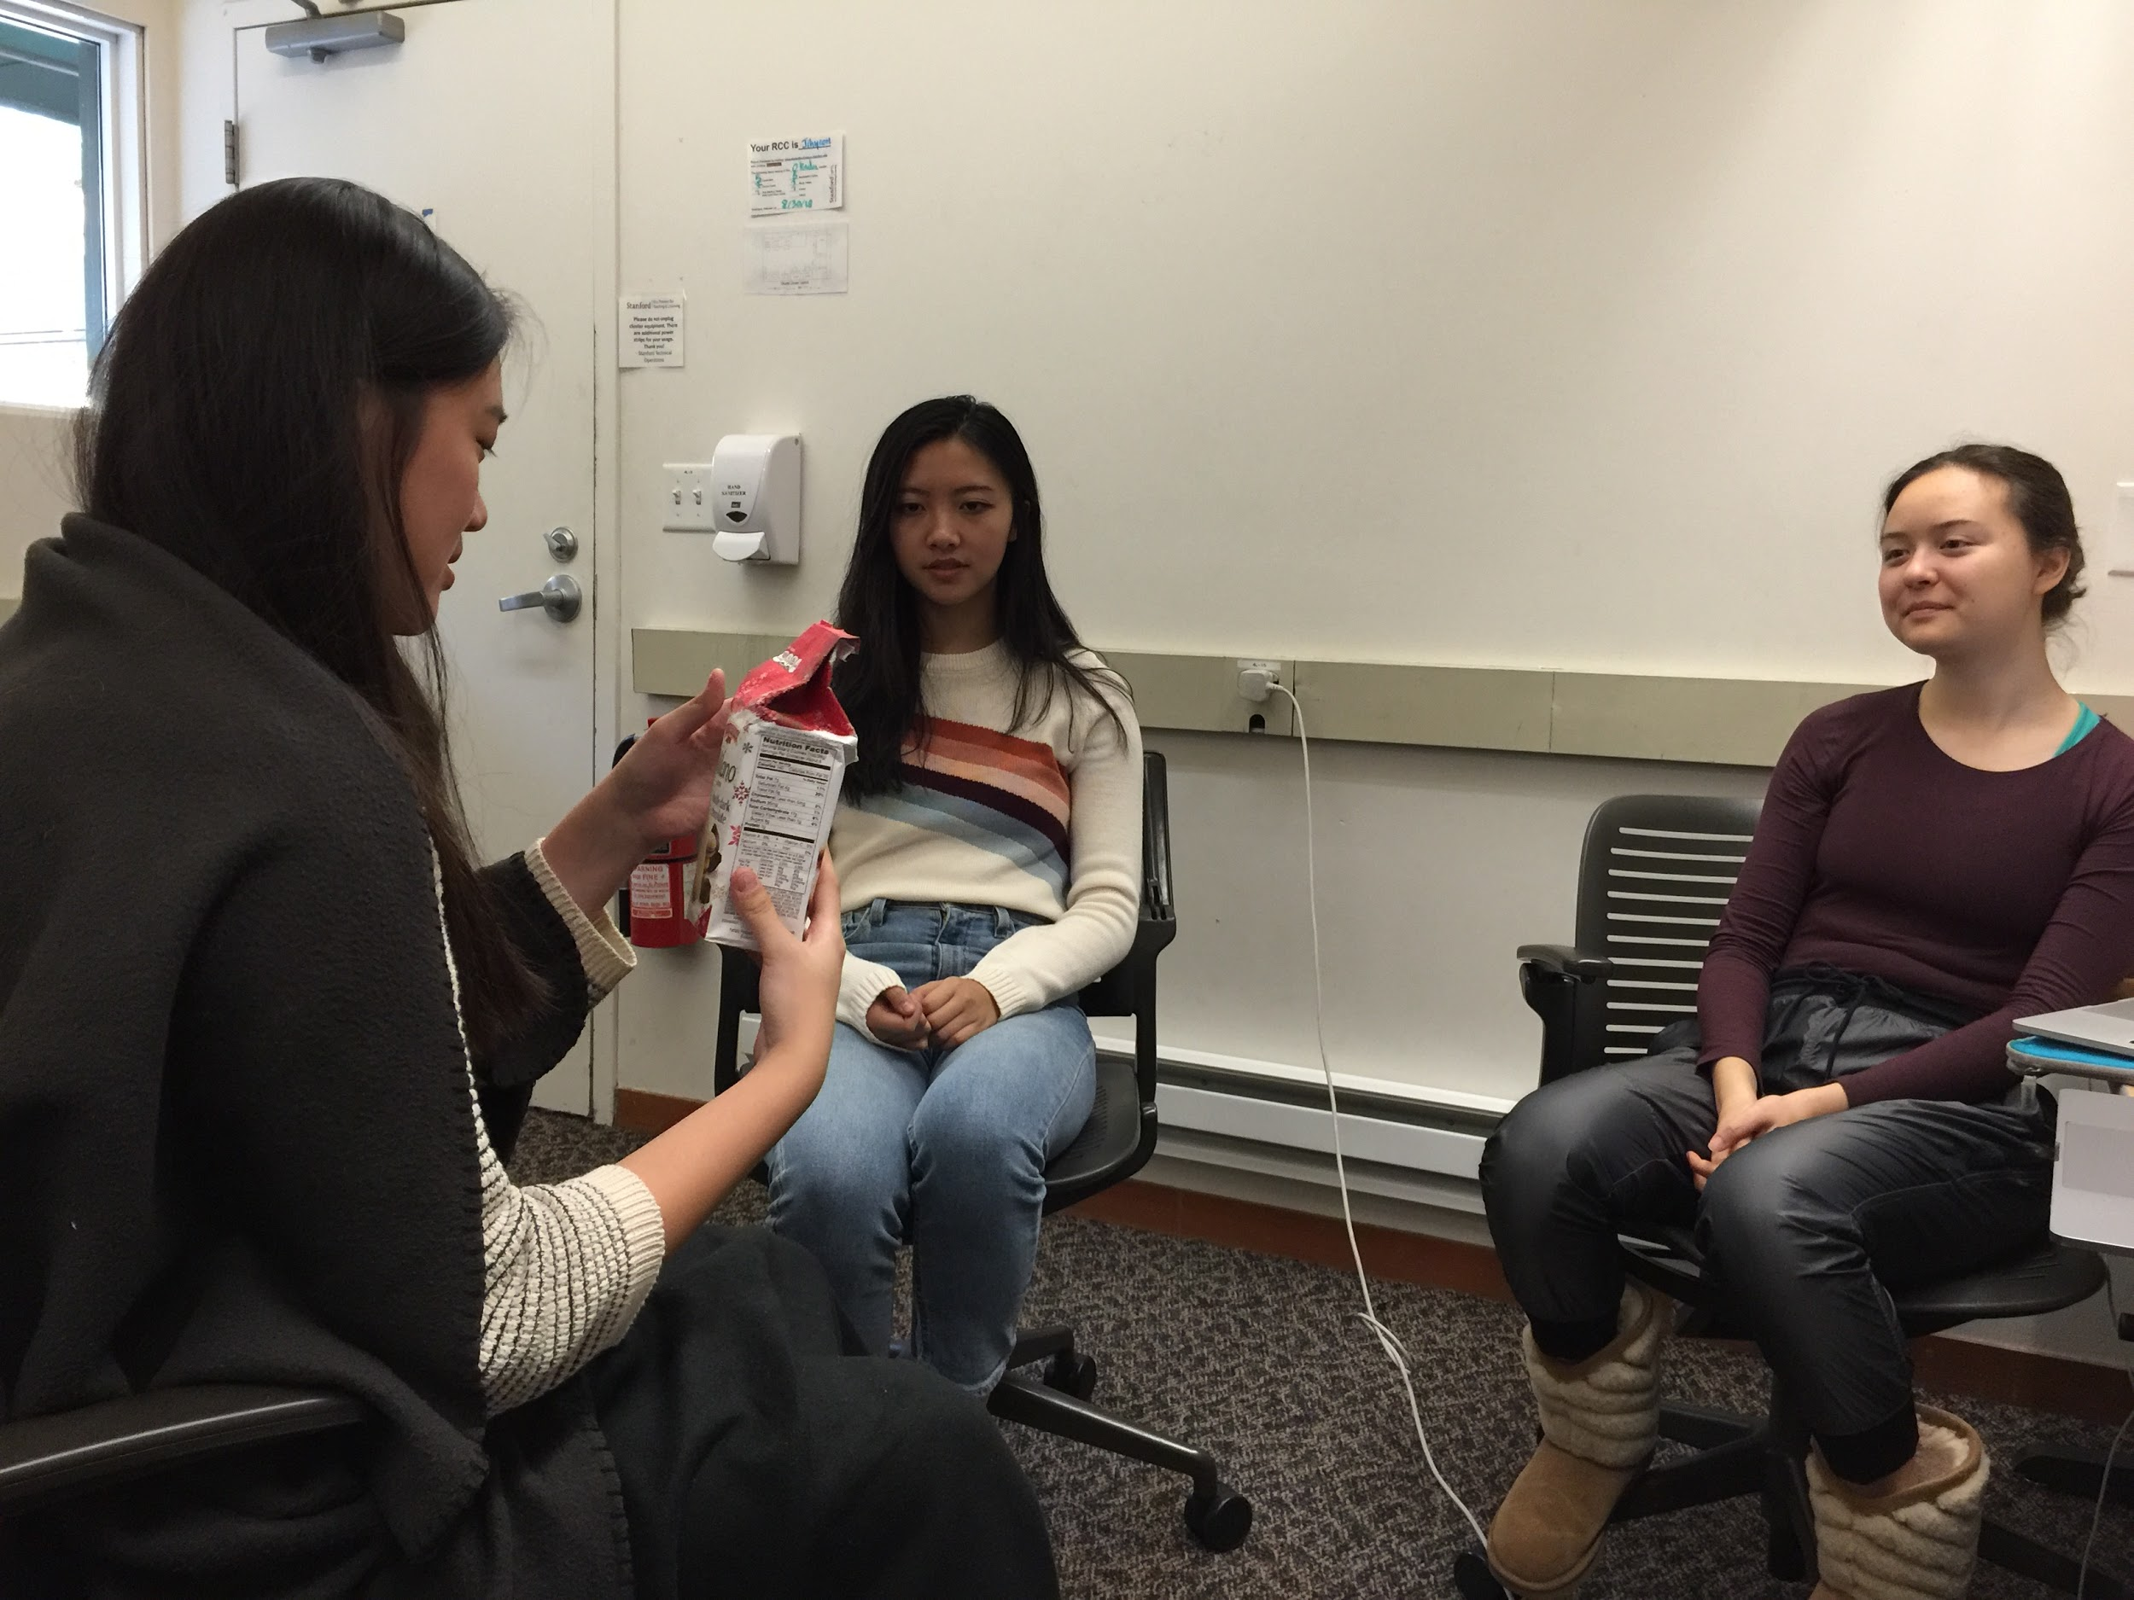
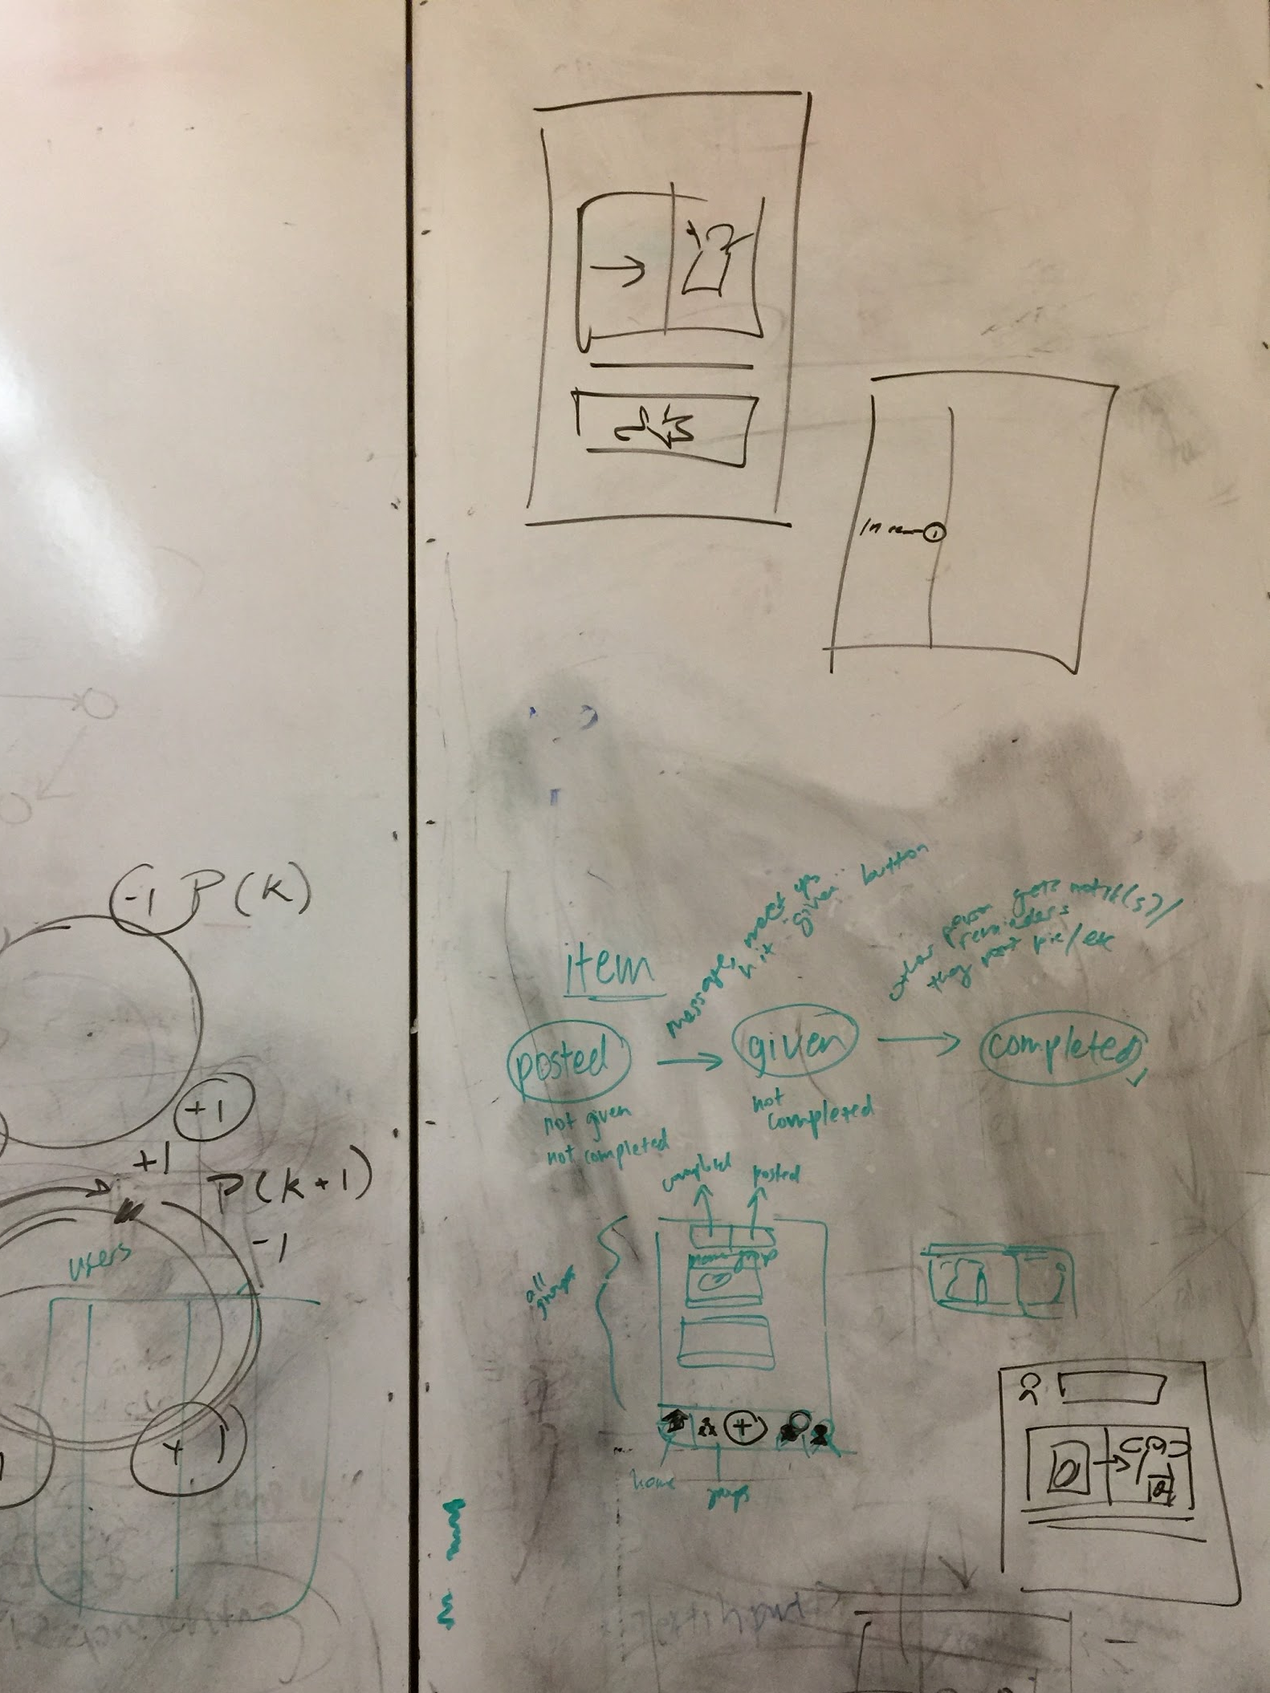
overview
HE feedback
design changes
implementation
status + plan
process
stories
how to exchange
search

Slide 16
overview
HE feedback
design changes
implementation
status + plan
process
stories
how to exchange
home
stories, fundamentally
completely new flow: receivers are asked to update the object’s story
language change: objects are “treasures,” not “items” or “things”
marking objects as given
completely new flow: givers and receivers communicate within the app
minor change: confirmation dialogs
tagging and searching
significant UI change: redesigned home page
minor change: keyword search*
editing objects (and later, stories)
minor change: edit buttons*
*realistically: stretch goals

Slide 17
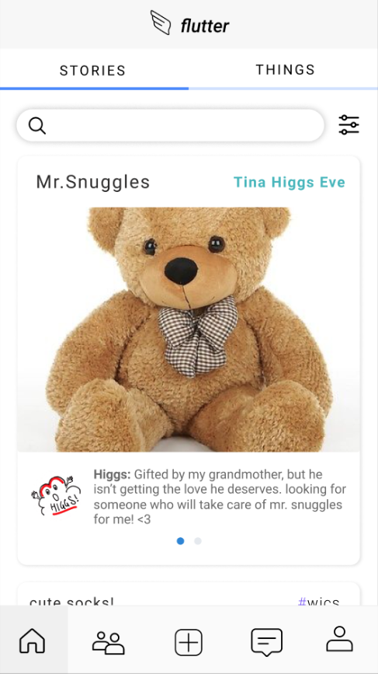
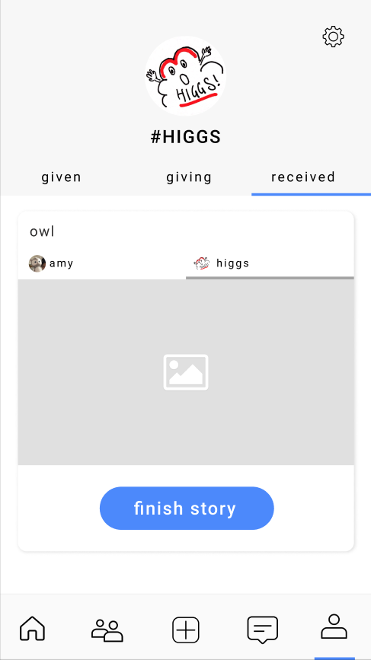
overview
HE feedback
design changes
implementation
status + plan
process
stories
how to exchange
home
revamped med-fi
stories are the first thing a user sees when they open the app
completely new flow: receivers are asked to update the object’s story

Slide 18
overview
HE feedback
design changes
implementation
status + plan
process
stories
how to exchange
home
revamped med-fi
stories are the first thing a user sees when they open the app
completely new flow: receivers are asked to update the object’s story

Slide 19
overview
HE feedback
design changes
implementation
status + plan
process
stories
how to exchange
home
revamped med-fi
stories are the first thing a user sees when they open the app
completely new flow: receivers are asked to update the object’s story

Slide 20
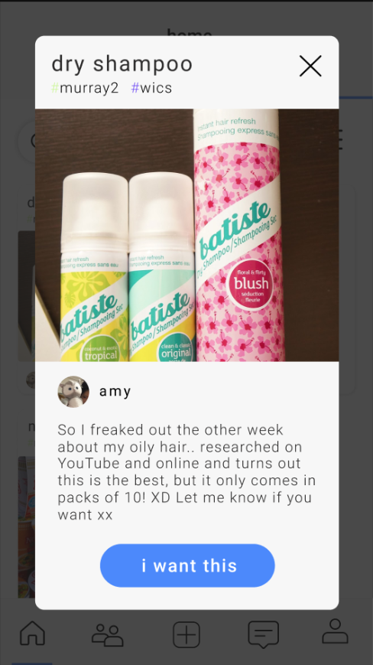
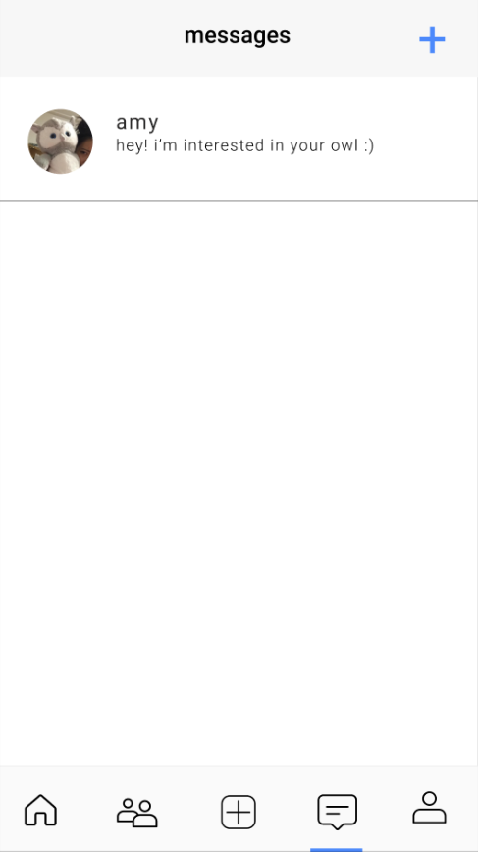
overview
HE feedback
design changes
implementation
status + plan
process
stories
how to exchange
home
revamped med-fi
chats allow givers and receivers communicate within the app
completely new flow: “i want this” → chat → exchange logistics → “mark treasure as gifted”

Slide 21
overview
HE feedback
design changes
implementation
status + plan
process
stories
how to exchange
home
revamped med-fi
chats allow givers and receivers communicate within the app
completely new flow: “i want this” → chat → exchange logistics → “mark treasure as gifted”

Slide 22
overview
HE feedback
design changes
implementation
status + plan
process
stories
how to exchange
home
revamped med-fi
chats allow givers and receivers communicate within the app
completely new flow: “i want this” → chat → exchange logistics → “mark treasure as gifted”

Slide 23
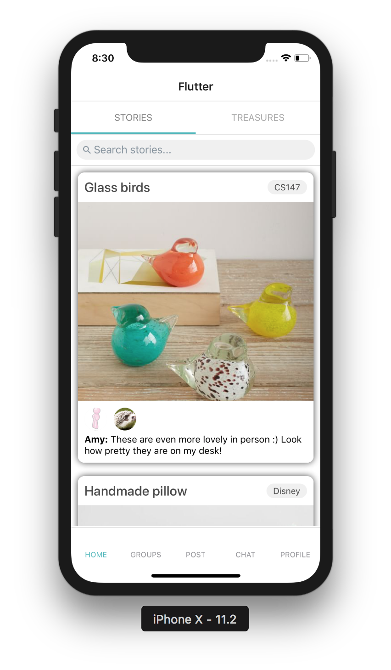
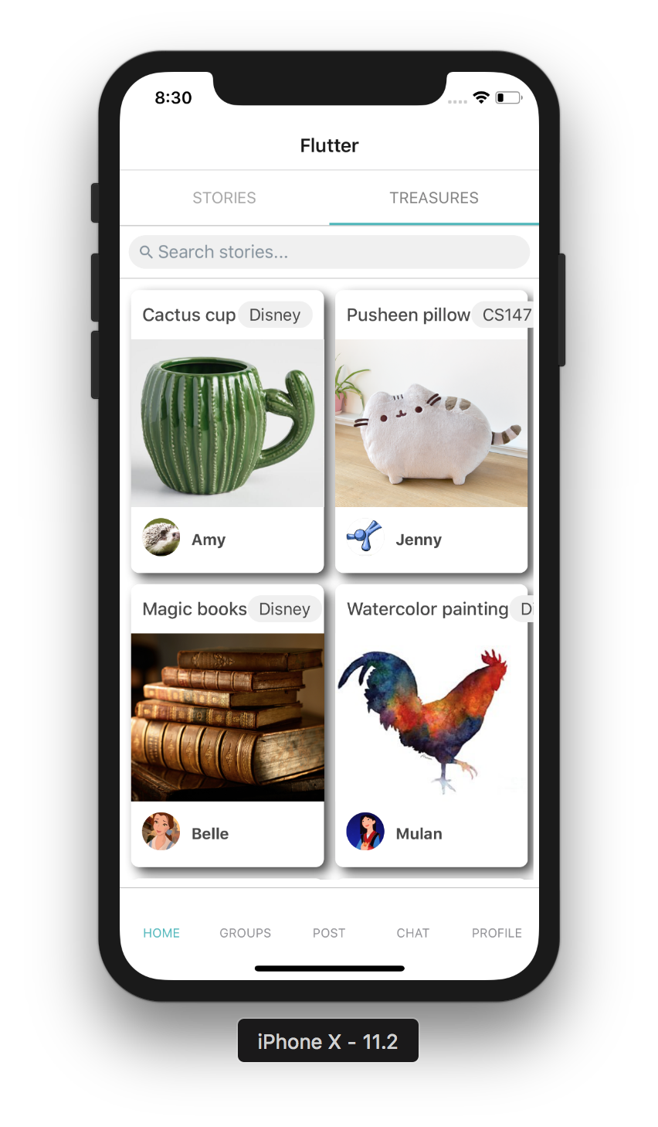
overview
HE feedback
design changes
implementation
status + plan
process
stories
how to exchange
home
hi-fi user interface
redesigned home page:
stories + treasures
hashtags removed, so search will be based on object descriptions
really proud of this

Slide 24
overview
HE feedback
design changes
implementation
status + plan
process
stories
how to exchange
home
hi-fi user interface
redesigned home page:
stories + treasures
hashtags removed, so search will be based on object descriptions
really proud of this

Slide 25
overview
HE feedback
design changes
implementation
status + plan
process
stories
how to exchange
home
hi-fi user interface
redesigned home page:
stories + treasures
hashtags removed, so search will be based on object descriptions
really proud of this

Slide 26
overview
HE feedback
design changes
implementation
status + plan
process
stories
how to exchange
home
hi-fi user interface
redesigned home page:
stories + treasures
hashtags removed, so search will be based on object descriptions
really proud of this

Slide 27
overview
HE feedback
design changes
implementation
status + plan
process
stories
how to exchange
home
hi-fi user interface
redesigned home page:
stories + treasures
hashtags removed, so search will be based on object descriptions
really proud of this

Slide 28



overview
HE feedback
design changes
implementation
status + plan
tools
wizard-of-oz
hard-coded data

Slide 29
overview
HE feedback
design changes
implementation
status + plan
tools
wizard-of-oz
hard-coded data
two people required to give/receive
demo day
no wizard-of-oz techniques required
before the demo, add plenty of example objects at different stages of being given/received
if we did another round of testing…
wizard-of-oz techniques might be required
ex. after the user posts an object, the “computer” fills in the interactions of another user who wants the object

Slide 30
overview
HE feedback
design changes
implementation
status + plan
tools
wizard-of-oz
hard-coded data
two people required to give/receive
demo day
no wizard-of-oz techniques required
before the demo, add plenty of example objects at different stages of being given/received
if we did another round of testing…
wizard-of-oz techniques might be required
ex. after the user posts an object, the “computer” fills in the interactions of another user who wants the object

Slide 31
overview
HE feedback
design changes
implementation
status + plan
tools
wizard-of-oz
hard-coded data
two people required to give/receive
demo day
no wizard-of-oz techniques required
before the demo, add plenty of example objects at different stages of being given/received
if we did another round of testing…
wizard-of-oz techniques might be required
ex. after the user posts an object, the “computer” fills in the interactions of another user who wants the object

Slide 32
overview
HE feedback
design changes
implementation
status + plan
tools
wizard-of-oz
hard-coded data
two people required to give/receive
demo day
no wizard-of-oz techniques required
before the demo, add plenty of example objects at different stages of being given/received
if we did another round of testing…
wizard-of-oz techniques might be required
ex. after the user posts an object, the “computer” fills in the interactions of another user who wants the object

Slide 33
overview
HE feedback
design changes
implementation
status + plan
tools
wizard-of-oz
hard-coded data
current
hard-coded
group names, members
story data
twilight zone
chats
database
all authentication
user profile data
object data
goal
hard-coded: none
everything will talk to the database

Slide 34
overview
HE feedback
design changes
implementation
status + plan
tools
wizard-of-oz
hard-coded data
current
hard-coded
group names, members
story data
twilight zone
chats
database
all authentication
user profile data
object data
goal
hard-coded: none
everything will talk to the database

Slide 35
overview
HE feedback
design changes
implementation
status + plan
tools
wizard-of-oz
hard-coded data
current
hard-coded
group names, members
story data
twilight zone
chats
database
all authentication
user profile data
object data
goal
hard-coded: none
everything will talk to the database

Slide 36
overview
HE feedback
design changes
implementation
status + plan
tools
wizard-of-oz
hard-coded data
current
hard-coded
group names, members
story data
twilight zone
chats
database
all authentication
user profile data
object data
goal
hard-coded: none
everything will talk to the database

Slide 37
overview
HE feedback
design changes
implementation
status + plan
tools
wizard-of-oz
hard-coded data
current
hard-coded
group names, members
story data
twilight zone
chats
database
all authentication
user profile data
object data
goal
hard-coded: none
everything will talk to the database

Slide 38



overview
HE feedback
design changes
implementation
status + plan
by task
by screen
stretch goals
demo
find an object
revamped med-fi
UI (no search)
database
give an object
revamped med-fi
UI
database
share new experiences with received object
revamped med-fi
UI
database
complete
partially complete
need to do

Slide 39
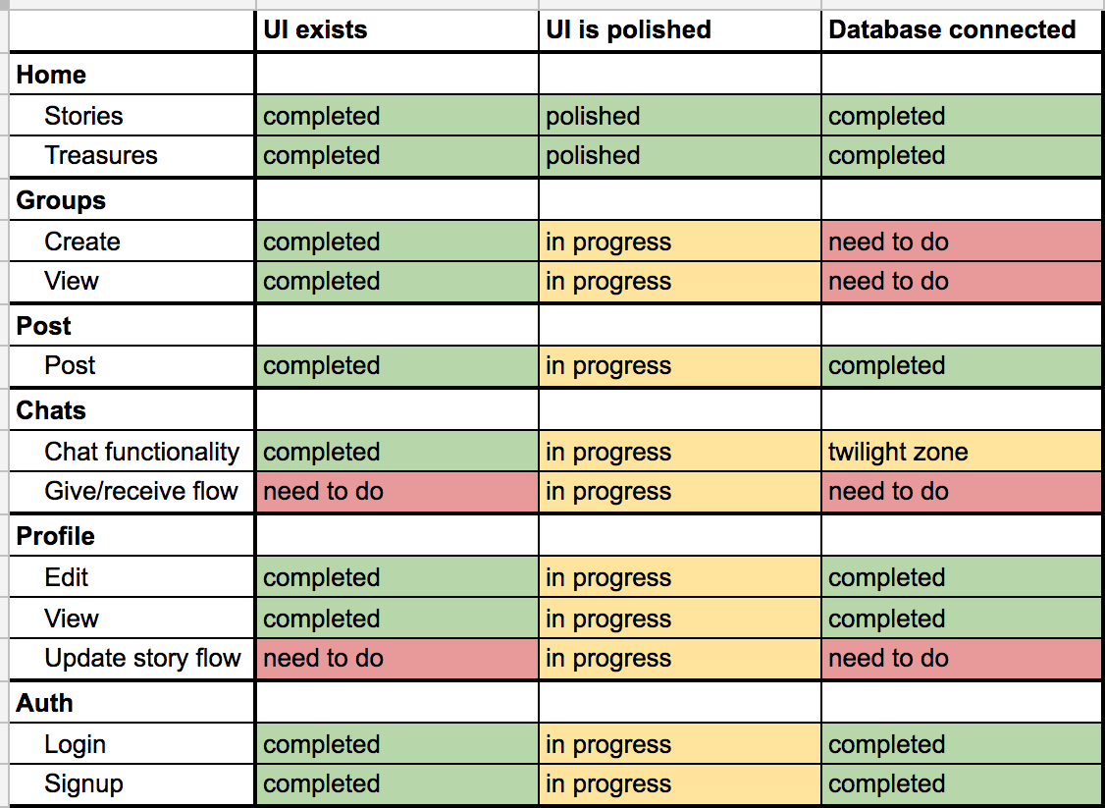
overview
HE feedback
design changes
implementation
status + plan
by task
by screen
stretch goals
demo
“is polished” includes
layout
error messages on forms
toasts for success/failure
(as needed) notification circle
(as needed) confirmation dialog

Slide 40
overview
HE feedback
design changes
implementation
status + plan
by task
by screen
stretch goals
demo
edit functionality
edit stories + objects
delete objects
add/remove people from a group
search functionality
keyword search for objects
user search for groups + messages
non-mission-critical login
change email/password
login with facebook
forgot password reset
see readme on github

Slide 41
demo time!
overview
HE feedback
design changes
implementation
status + plan
by task
by screen
stretch goals
demo

